Slide 1

Storage Talk

Slide 2
Topics
介紹儲存產業
介紹工作類型
可加強的科目
可研究的主題

Slide 3
FalconStor Inc.
Founded: 2000 @ New York, U.S.
Nasdaq: FALC
Products: VTL, NSS, CDP, FDS and FreeStore.
Awards:
2008, #5 in the Forbes list of 25 fastest growing technology companies.
2011, CRN: List of 25 “Need to Know: Storage Vendors”.
2015, SVC Awards: Virtualisation/Software Defined Storage Product of the Year.
2016, FINALIST: Storage Product of the Year.

Slide 4

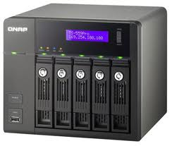
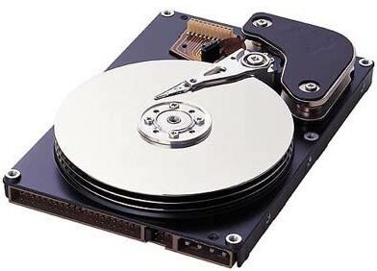
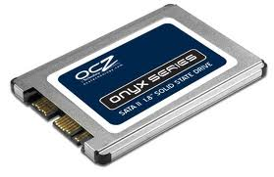

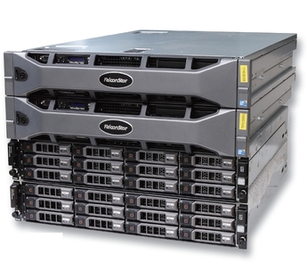
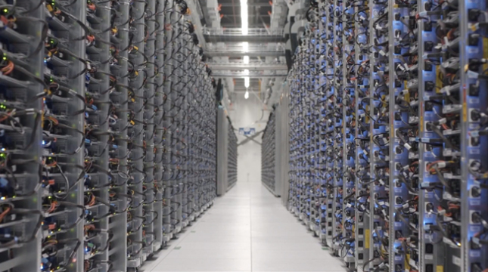
Storage

Slide 5
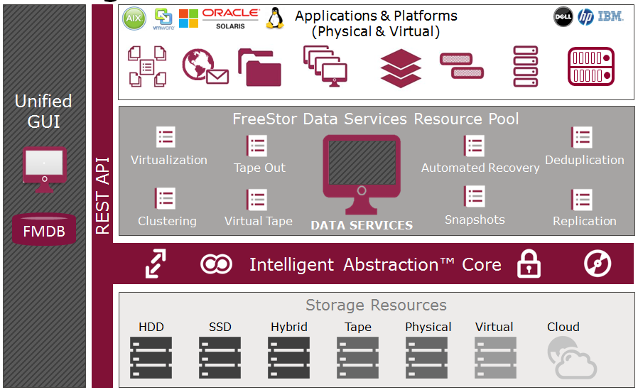

Slide 6
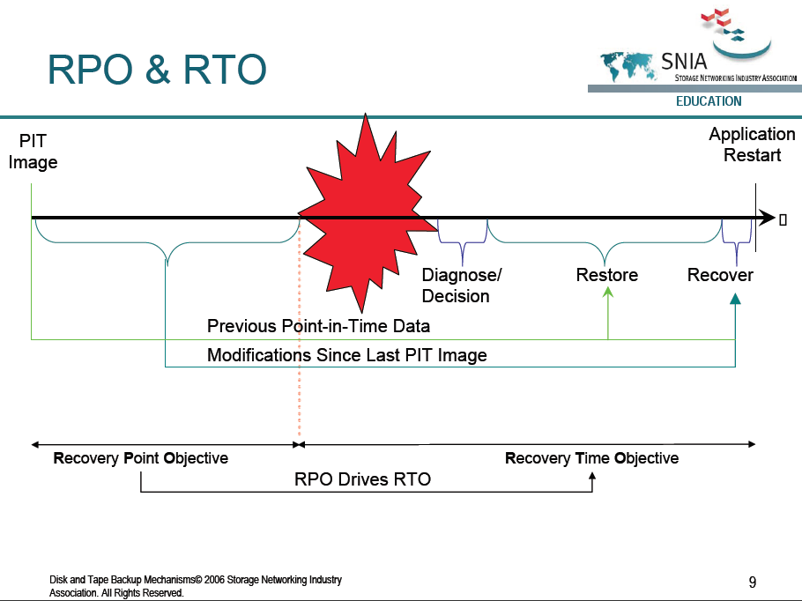
Data Availability
Backup / Restore / Recovery
Mirror, Replication and Failover
RPO & RTO
能承受的資料損失 &能承受的停機時間

Slide 7
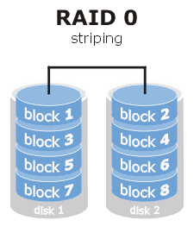
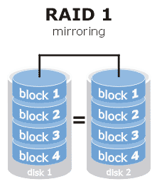
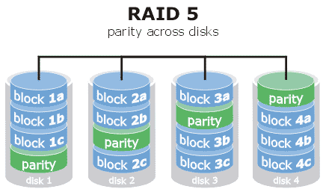
Backup & Restore
File copy / Disk clone
Backup
Fully / Incremental / Differential
RAID
REF: http://www.prepressure.com/library/technology/raid

Slide 8
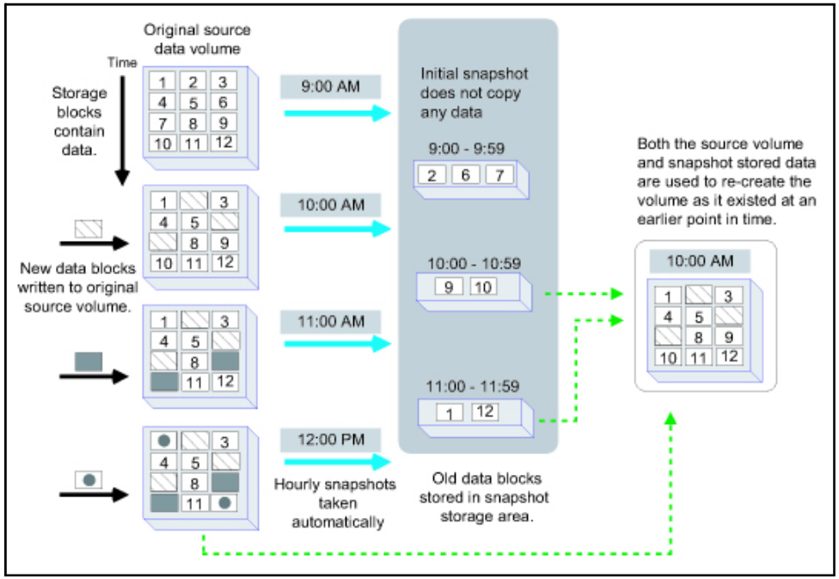
Snapshot

Slide 9
NAS
NAS
Network-Attached Storage
NFS/CIFS
Client
LAN
NAS

Slide 10
SAN
Storage Area Network
SAN
iSCSI/FC
Server
Server

Slide 11
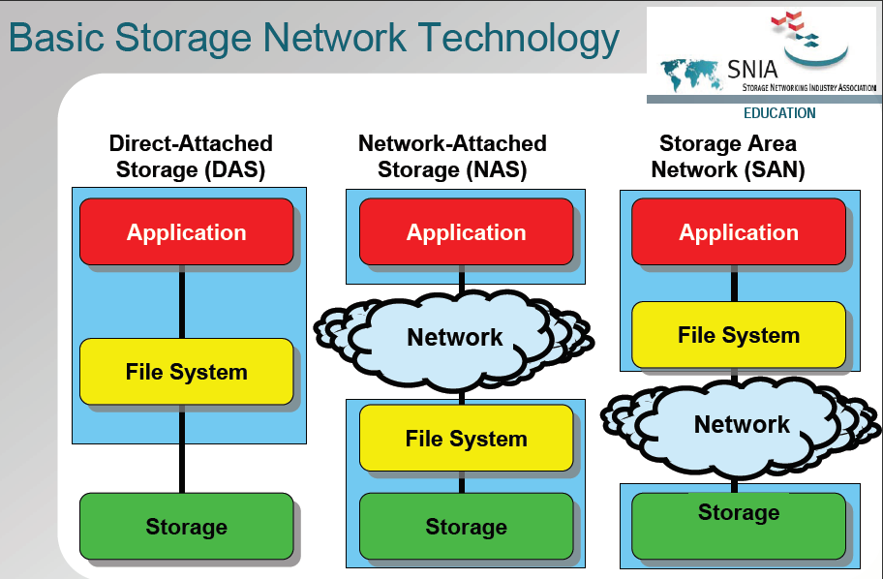

Slide 12
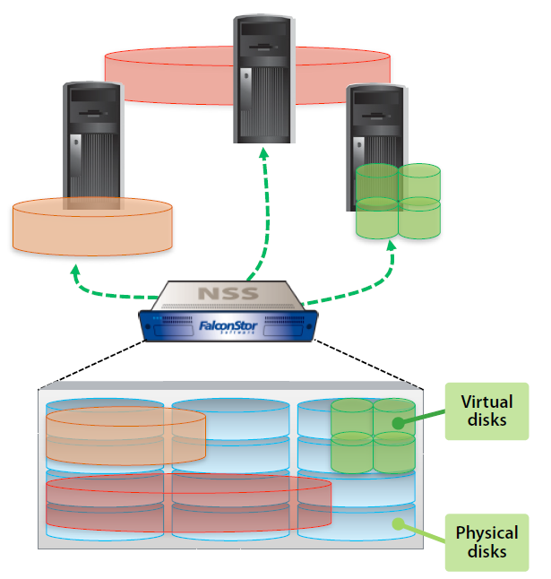
Storage Virtualization
Mapping
Thin Provision
Storage Pool
Heterogeneous storage
Enhanced storage utilization
Central management
Easy for backup & restore

Slide 13
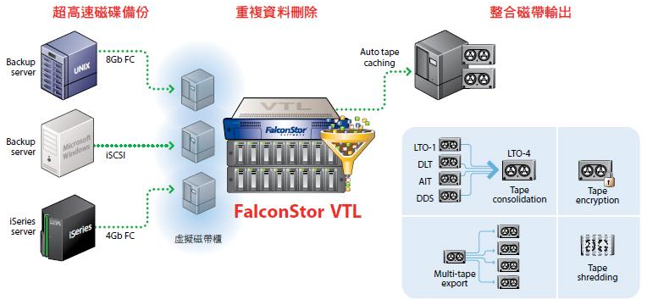
VTL & Dedupe
Compress
File level
Dedupe
Block level

Slide 14


Local Data Protection and Recovery
Snapshots agents are triggered to create consistent recovery points
Application Data integrity check points
TimeView
TimeView provides a Point-in-Time view of a previous version of a vDev
The resource is available almost immediately
Minimal storage allocation is required only to temporarily store writes sent to the TimeView*
TimeMark Copy
A full-size copy of the vDev as it existed at the time of the snapshot used. Because a full and complete copy id being made, the TM Copy vDev is available at the end of the copy process
Once mounted, the TimeMark Copy vDev is a totally independent vDev
Rollback
Use a selected snapshot to completely revert the primary vDev to its state at the date and time of the snapshot
Requires vDev dismount until rollback is complete
vDev is available to be mounted again at the end of the process
SAN Disk Manager
Snapshot Agent
File System Agent
Host based applications
Message Recovery
HyperTrac
Application Server
TimeMark Copy
(Cloning)
TimeView
(PiT View)
DB
LOG
DB
LOG
I/O Transactions
Independent Image
Temporary Image
Rollback
TimeMark (Snapshot)
8:00AM
DB
LOG
DB
LOG
SRA
SRA
DB
LOG
Snapshot Resource Area
9:00AM
vDev's
10:00AM
DB
LOG
COFW
Preserved Images

Slide 15

Replication
Standby Application Server
Application Server
3 - TimeMark protects data in the Replica Resource in case replication is interrupted before the stable image is completely transferred
1 - When a replication is triggered a temporary TimeMark is created on the both Primary & Replica Disks and then an internal TimeView is created
Promote
2 -Frozen Data is read from the internal TimeView according to U-Map and differences are sequentially transferred to the replica
DB
LOG
Internal TimeView
Target Site NSS
DB'
LOG'
vDev
DB
LOG
Replica Disk
Snapshot Area
Replication Snapshot
Rollback if
Replication fails
10:00AM
DB
LOG
Available only is TimeMark is enabled on replica
8:00AM
DB
LOG
Preserved Image
DB
LOG
9:00AM
Primary NSS
DB
LOG
10:00AM
Preserved Images

Slide 16







Disaster Recovery in VMware Environments
V2V Instant Recovery
P2V Instant Recovery
APP
OS
VMDK
Virtual Machine
APP
VMWare Converter
OS
RDM
Virtual Machine
SAN Disk Manager
Snapshot Agent
File System Agent
Physical Server
VMWare
ESX Server
= TimeView vDev
= OS Virtual/Physical Volume
= ESX Datastores on NSS vDev’s

Slide 17

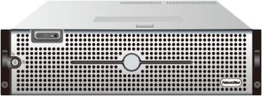
Failover
Application Server
Application Server
Application Server
Application Server
Disk1
Disk2
Disk1
Disk2
Heartbeat
Disk1
Stdb2
Disk2
Stdb1
Disk2
Disk1
SCI ( Storage Cluster Interlink)
P1
P2
P1
P2
Shared Storage
Shared Storage

Slide 18
Tech Engineers
Systematical thinking
Tech & product knowledge
Team work
RD
Programming / Debug
Improve performance
QA
Test Cases / Automation
Heterogeneous test environments
Support
Communication
Storage Architect

Slide 19
RD activities
Research and development.
Document specification.
Code review.
Testable code.
Event logs.
Debug messages.
Bug fix.
Tools: IDE / GCC / GDB / Git

Slide 20
QA activities
Review and reproduce incoming bug reports.
Verify bugs that RD fixed.
Setup test environment and test new builds.
Define test cases.
Automatic regression tests.
Report defects.
Analyze defect report to provide quality level (defect find and fix rates), also make recommendations for improve product quality.

Slide 21
Support activities
Follow up customer’s issue.
Investigate customer’s issue and reproduce it if needed.
Escalate issue if suspect the issue is a bug.
Skill: Second foreign language.

Slide 22
Fundamental Courses
Operating System
System Programming
Computer Networking
Programming Languages
C/C++, Java, Scripts
Object Oriented Analysis and Design

Slide 23
Interesting Topics
System administrator
Linux
Windows
Cluster
Virtualization
VMWare
Hyper-V
Programming
Driver, Networking, REST API, ZeroMQ, JSON,…
OpenStack

Slide 24
Resources
Sourceforge (sourceforge.net)
Github (github.com)
Stack overflow (stackoverflow.com)

